Slide 1


Predictive Modeling and Team Performance Analysis in IPL
Supervisor: Mr. Vivek Kshirsagar
Name: Rohit Moholkar
Student Id: 10613711

Slide 2


Presentation Includes Following Points:
Introduction.
Literature Review.
Methodology.
Data Analysis.
Feature Engineering.
Machine Learning.
Graph of Win/Lose Probabilities.
Results.
Challenges.
Future Scope.
Conclusion.

Slide 3

INTRODUCTION
Cricket's Global Impact.
T20 Cricket Format.
IPL's Evolution and Innovation.
Overview of IPL Franchises and Teams.
Understanding about Data.
Data Analytics in Professional Cricket.
Empowering Stakeholders Through Understanding.
Machine Learning's Impact on Cricket Strategy.
Evolutionary Impact on Cricket Culture.
Enhancing the Cricketing Experience.

Slide 4
LITERATURE REVIEW
(Nimmagadda, n.d.) Cricket score and winning prediction using data mining.
(Petersen, 2008) IPL 2008 season analysis.
(Vistro, 2019 ) Using machine learning and data analysis predicting cricket winners.
(Jaipuria, 2022) Toss and Venue impact on the match result.
(Sinha, 2020) Enhancing performance of the team with support vector machine in IPL.
(Thorat, 2021) Review paper on cricket score prediction.
(Patil, n.d.) Cricket team prediction using machine learning techniques.
(Kapadia, 2019) A study on match outcome using machine learning.

Slide 5

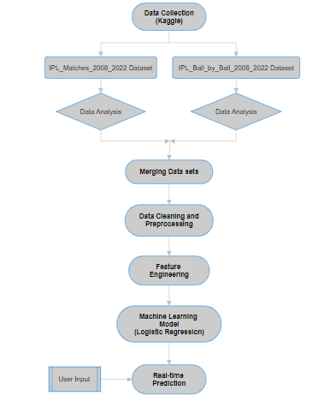







METHODOLOGY

Slide 6
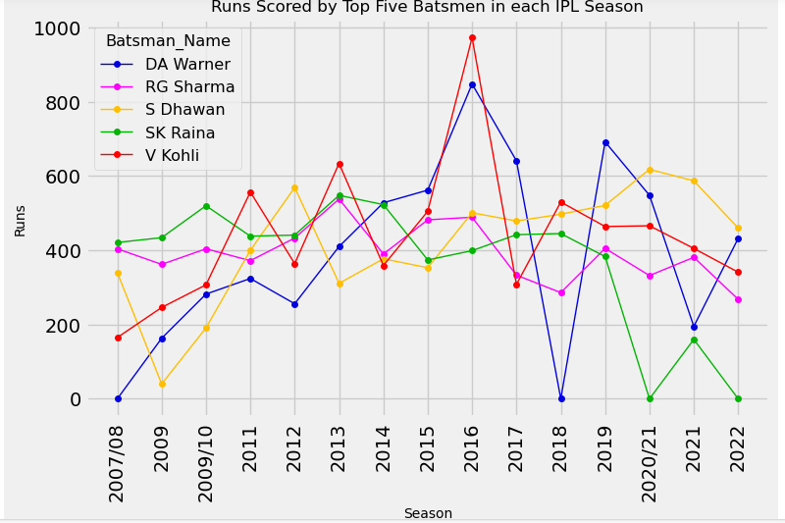
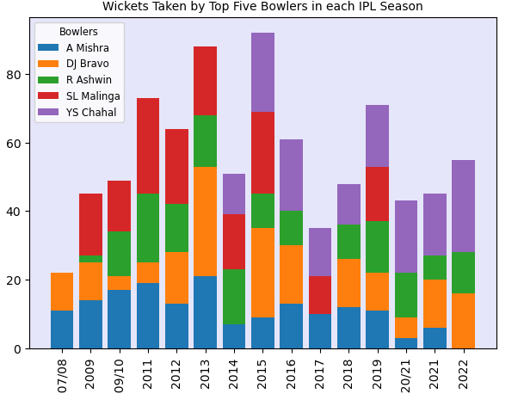
DATA ANALYSIS

Slide 7

FEATURE ENGINEERING
Addressing Missing Values.
Merging Datasets.
Data Cleaning.
Ensuring Consistency in Columns.
Creating Additional Columns.
Fixing Inaccuracies.
Generating Dynamic Features.
Handling Null and Infinite Values.
Creating Target Variable.
Removing Unnecessary Columns.

Slide 8
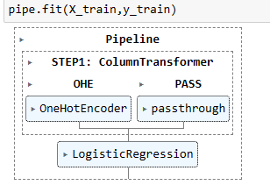
MACHINE LEARNING
Selecting Features and Target Variable.
Creating Column Transformer.
One-Hot Encoding (OHE) for Categorical Column.
Pipeline Construction.
STEP1 - Data Transformation.
STEP2 - Logistic Regression Model.
Fitting the Pipeline.
Feature Importance.
Accuracy Score Calculation.
Cross-Validation for Accuracy Check.
Winning Probabilities DataFrame.

Slide 9
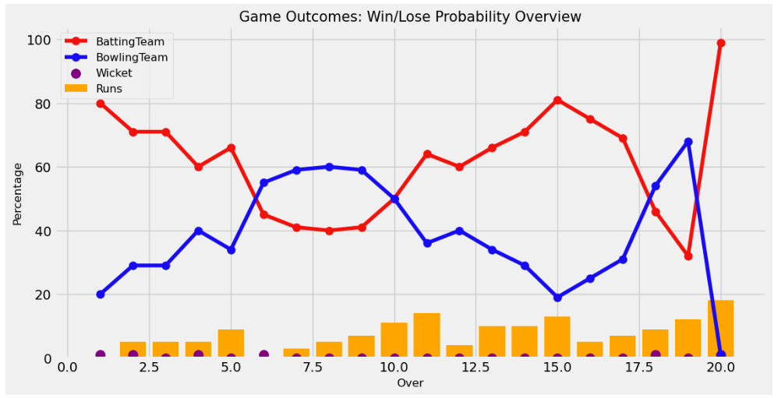
GRAPH OF WIN/LOSE PROBABILITIES

Slide 10
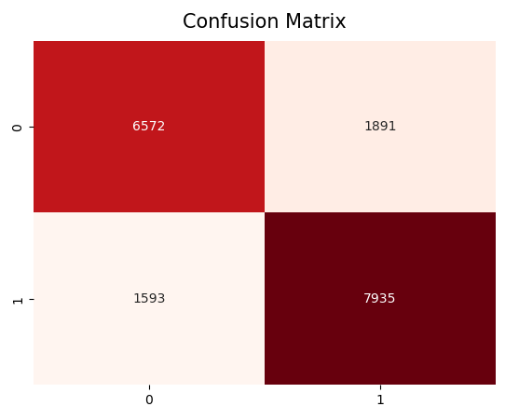
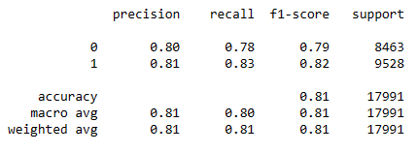
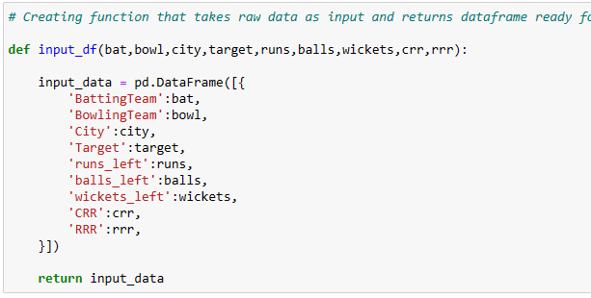
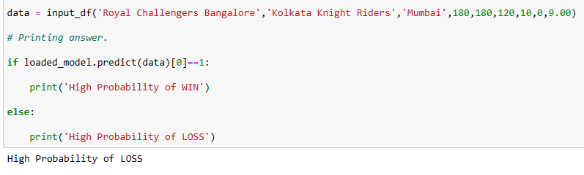
RESULTS

Slide 11

CHALLENGES
Diverse Datasets.
Cricket Context Understanding.
Exploratory Data Analysis. (EDA)
Handling and Cleaning of the Raw Data.
Robust Data Preprocessing.
Calculation Complexity.
Bug Fixing and Accuracy.
Feature Engineering Challenges.
Ensuring Data Uniformity.
Model Evaluation.

Slide 12
FUTURE SCOPE
Data Integration in Real Time.
Consider External Factors.
Create Community Involvement.
Work with Experts.
Develop interactive Application or Website.

Slide 13

CONCLUSION
Comprehensive IPL Journey.
Essential Analysis Stages.
Deep Dives into Player Performances.
Innovative Statistical Functions.
Fusion of Statistics and Machine Learning.
Future Possibilities and Innovations.
Innovation in Real-Time Predictions.
Sporting Insights Beyond Statistical Exploration.
Data Science's Impact on Cricket Understanding.

Slide 14
THANK YOU

